Slide 1

ADVANCED OBJECT ORIENTED PROGRAMMING LABORATORY
Course Code: CSE- 2118
Section: G
Dept. of CSE, UIU
Submitted By
Md. Fahim Zayed Ripon - 0112420296
Shahriar kazol - 0112310592 Jayed bin khalid - 112230880
Submitted To
Mr. Tonmoy Saha Lecturer
Dept. of CSE, UIU

Slide 2

Content
1
1.1
1.2
1.3
2
2.1
2.2
3
4
5
Introduction Motivation Object Purpose
Project Description List of Features
Description of Each Features
Snapshots of the Project Future Plans
Conclusion.

Slide 3
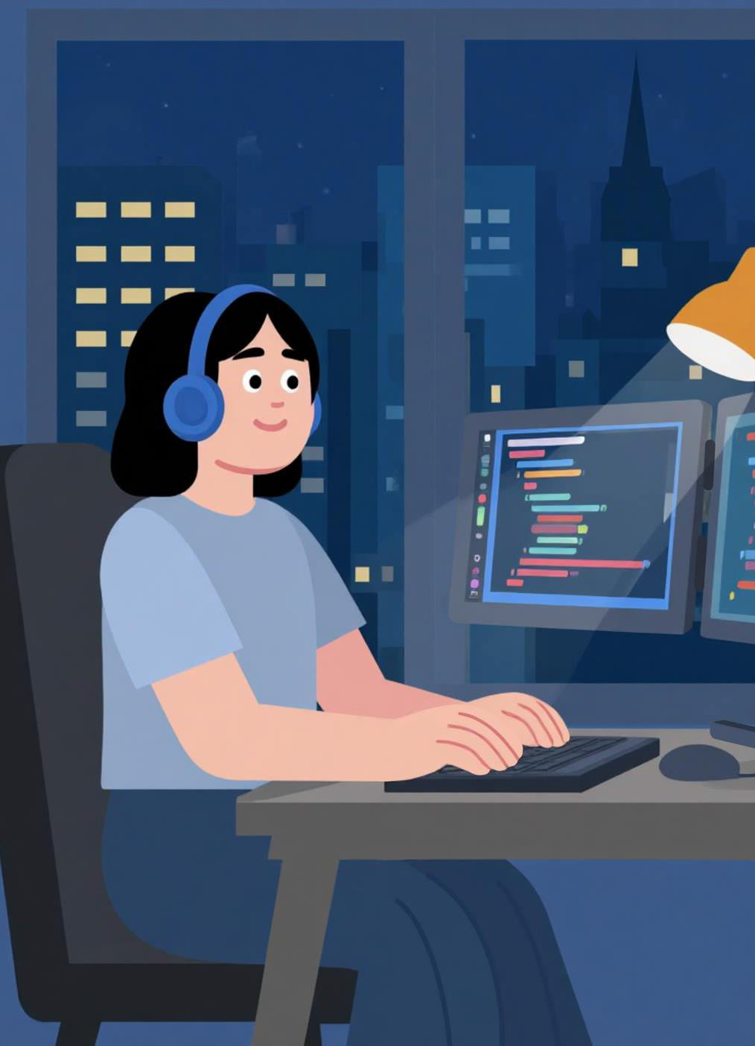
1. Introduction
Concept: A simple, engaging system combining two classics: Hangman and Tic-Tac-Toe.
Goal: To demonstrate fundamental programming skills (loops, conditionals, functions, I/O) in a practical way.
Core Tech: Built on Java (programming) and features design tools like JavaFX and Scene Builder.
Backend: Utilizes JavaFX for backend and MySQL for data management.
Interface: Currently runs on a simple text-based interface.
Key Skill: Showcases modular, beginner-friendly code that is easily extendable (e.g., to GUI or multiplayer).
Impact: Enhances vocabulary, logical thinking, and strategy.

Slide 4




01
Combine learning with fun through classic games.
1.1 Motivation
02
Encourage logical thinking, decision-making, and problem- solving.
Strengthen understanding of loops, conditionals, arrays, and user interaction.
03
04
Enhance creativity and teamwork.
05
Create simple, engaging, and enjoyable games for all users.

Slide 5



To design and develop simple, interactive games that are easy and enjoyable to play.
01
To practice and strengthen fundamental programming concepts such as loops, conditional statements, arrays, and user input handling.
To enhance logical thinking, problem-
solving skills, and strategic planning through game development.
1.2 Project Objectives
To demonstrate how basic programming knowledge can be applied to create functional and engaging applications.

Slide 6




1.3 PROJECT PURPOSE
Create interactive and engaging games to make programming fun.
Practice core programming concepts: loops, conditionals, arrays, user input.
Improve logical thinking, problem-solving, creativity, and strategy.
Deliver enjoyable and educational gaming experiences for users.

Slide 7


2. Project Description
The Hangman and Tic Tac Toe project is a collection of two classic games developed to provide an interactive and educational experience.
Hangman: In this game, the player tries to guess a hidden word by suggesting letters within a limited number of attempts. The game helps improve vocabulary, spelling, and logical thinking.
Tic Tac Toe: This is a two-player game where players take turns
marking spaces in a 3×3 grid, aiming to get three of their marks in a row. The game encourages strategic thinking and planning.
The project is developed using basic programming concepts such as loops, conditional statements, arrays, and user input handling

Slide 8
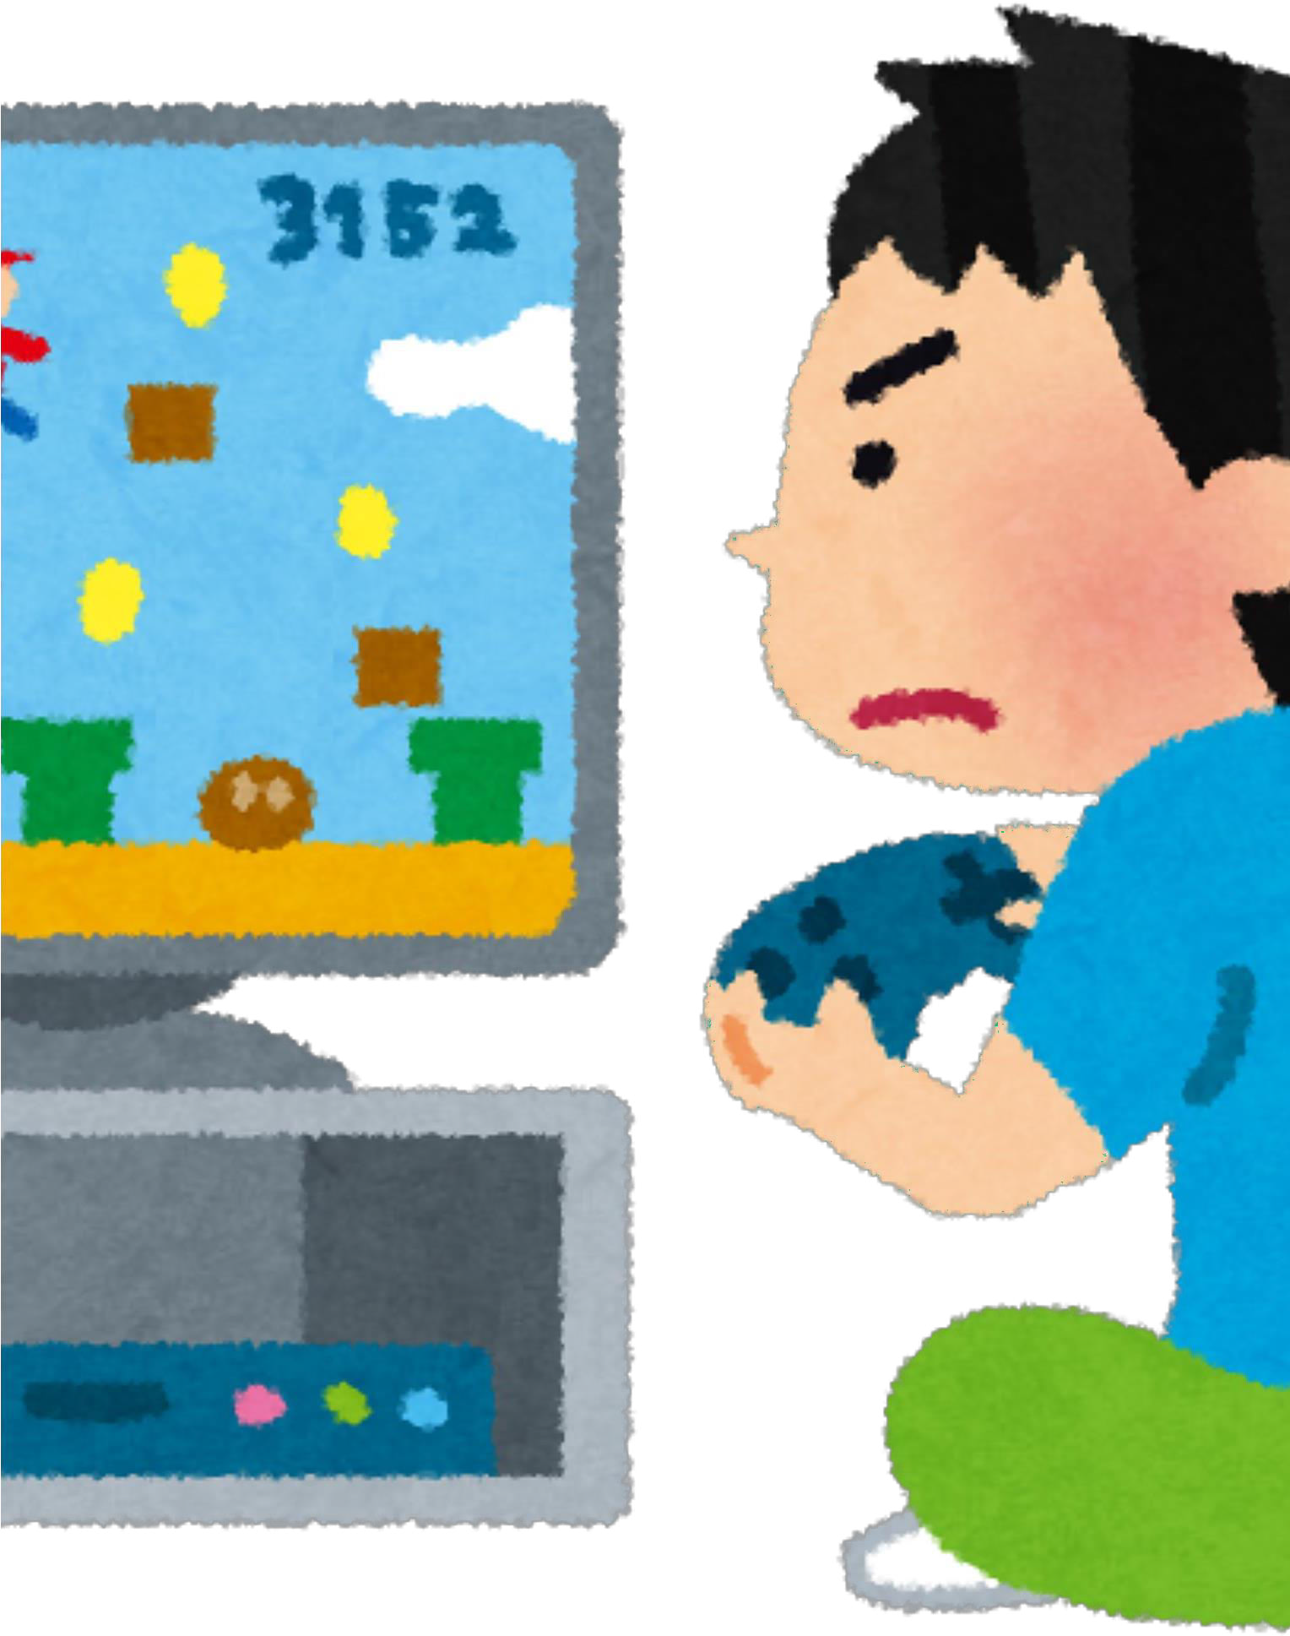
Project Features
Hangman:
Easy, user-friendly gameplay.
Random word selection.
Limited guessing attempts.
Shows correct letters and remaining tries.
Restart option available.
Tic Tac Toe:
Two-player mode on same device.
Simple 3×3 grid layout.
Detects winners or draws.
Restart option included.
General:
Simple, interactive design.
Works in console or GUI.
Promotes logic, problem-solving, and strategy.

Slide 9

DESCRIPTION OF EACH FEATURE
HANGMAN FEATURES:
Easy-to-use interface: The game provides a simple and clear interface where users can see the word to guess, remaining attempts, and letters guessed so far.
Random word selection: Each game selects a word randomly from a predefined list, making each session unique and challenging.
Limited attempts for guessing: Players have a fixed number of tries to guess the word, which adds excitement and encourages careful guessing.
Shows correct letters and remaining tries: Correctly guessed letters are displayed in their positions, and remaining attempts are clearly shown to help players track progress.
Option to restart the game: Users can start a new game anytime after finishing the current one.

Slide 10
DESCRIPTION OF EACH FEATURE
Tic Tac Toe Features:
Two-player mode: Two players can play on the same device, taking turns to mark the grid.
Clear 3×3 grid: The game board is displayed clearly, making it easy for players to mark their moves.
Detects winner or draw: The game automatically checks for winning conditions or a draw and announces the result.
Option to restart the game: Players can start a new match without restarting the program.

Slide 11

DESCRIPTION OF EACH FEATURE
General Features:
Simple and interactive design: Both games are designed to be user-friendly and engaging, suitable for learners of all ages.
Enhances logical thinking and problem-solving: The games provide mental challenges that improve decision-making and strategic skills.

Slide 12

DESCRIPTION OF EACH FEATURE
Rock–PapeScissors Features:
Rock Paper Scissors is a simple yet classic hand game where two players simultaneously choose one of three options—rock, paper, or scissors. Rock beats scissors, scissors cuts paper, and paper covers rock. The winner is decided based on these straightforward rules.

Slide 13
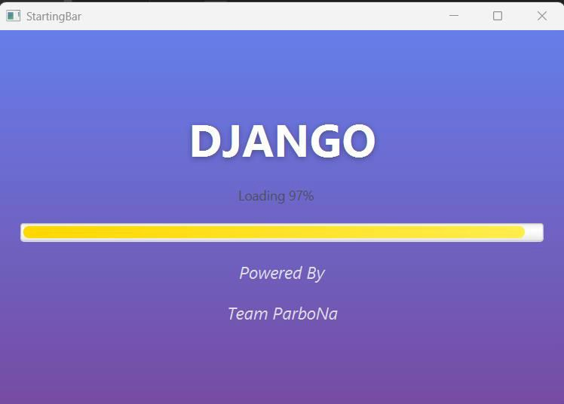
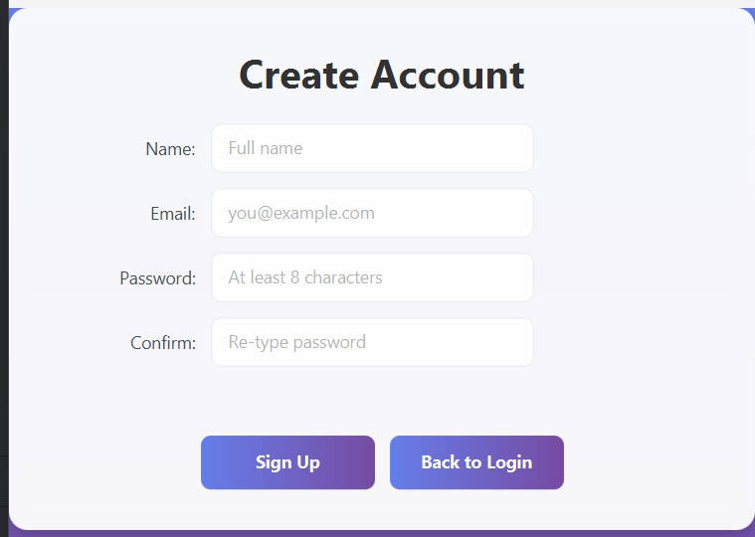
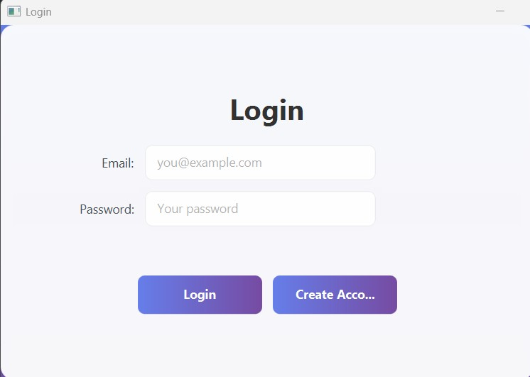
3. Snapshots of the Project DJANGO
user authentication includes login, registration, email verification, and password recovery. Users can log in with their email and password, and during registration, an email verification link is sent to confirm their account. If they forget their password, a reset link is sent to their registered email. Only one account can be created per email, ensuring unique user registration and secure access to the system.
Login & registration page

Slide 14
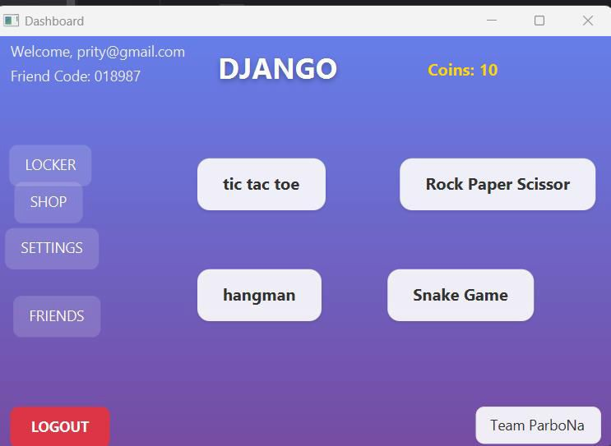
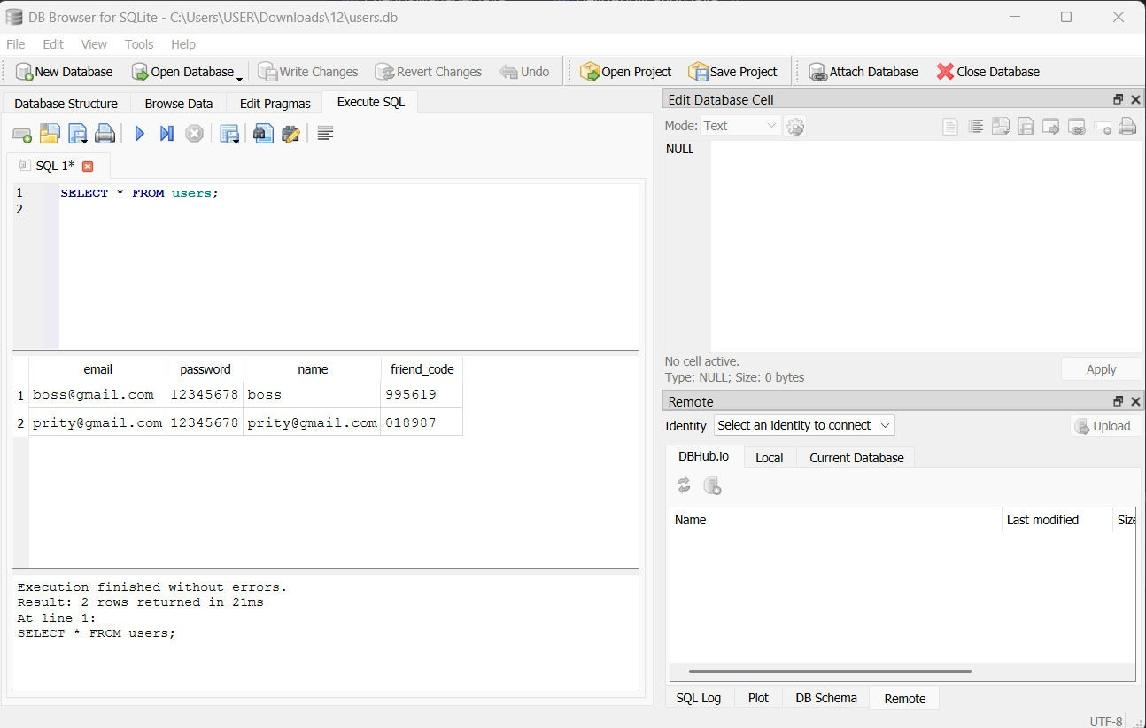
Dashboard
DATABASE

Slide 15
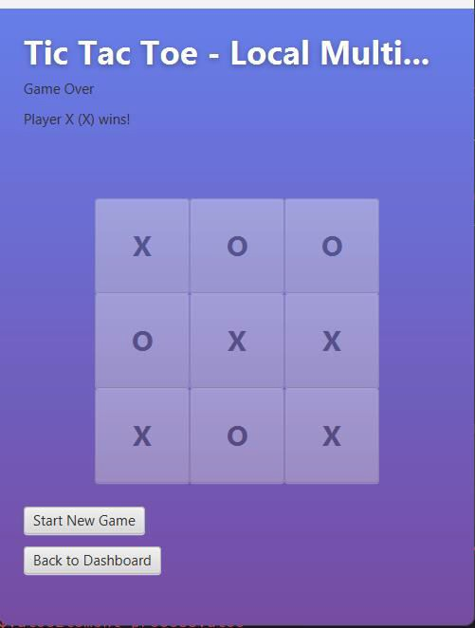
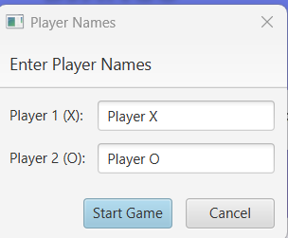
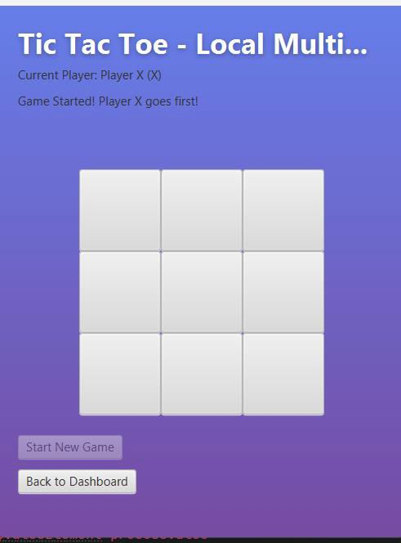
TIC-TAC-TOE

Slide 16
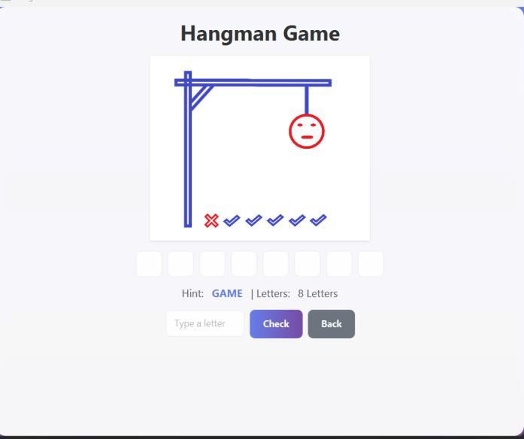
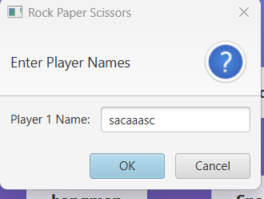
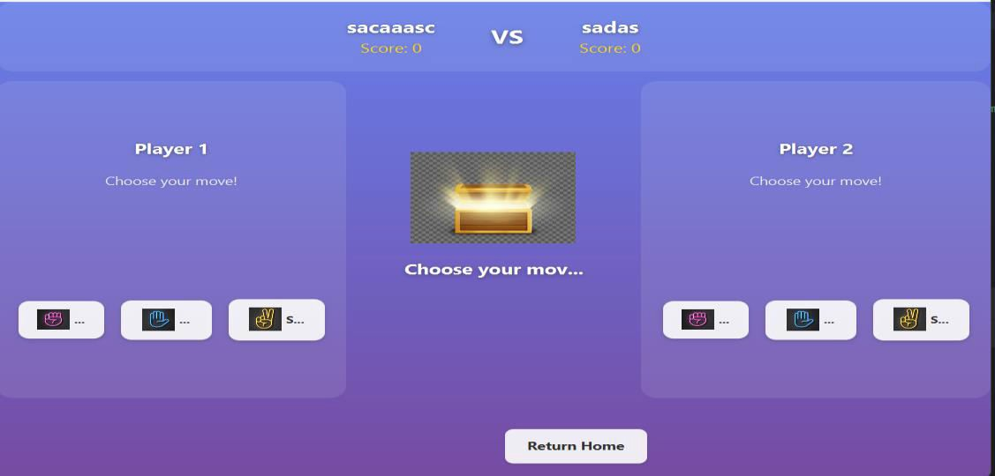
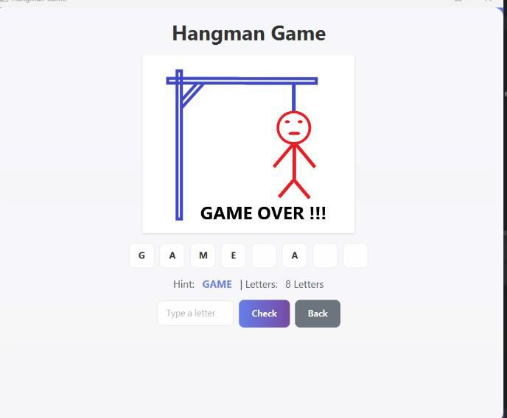
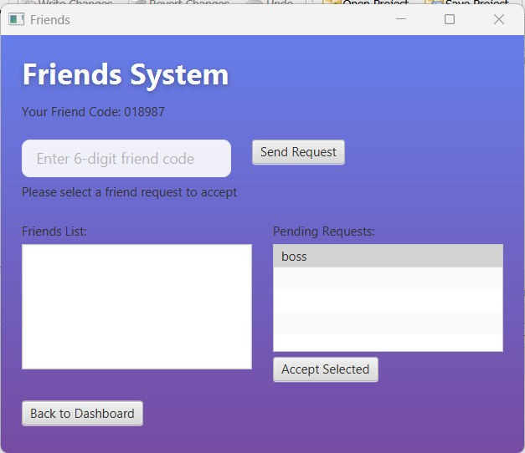
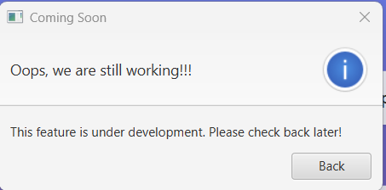
HANGMAN
ROCK PAPER SCISSIORS
ADD FRIENDS
FOR OTHER INACTIVE BUTTON (ONE NOTIFICATION)

Slide 17

Future Plans
Add a Graphical User Interface (GUI): Improve the games by creating visually appealing graphics instead of a console-based interface.
Single-player mode with AI: Implement a computer opponent for Tic Tac Toe, allowing single-player gameplay with different difficulty levels.
Word categories in Hangman: Include multiple categories (e.g., animals, countries, movies) to make the game more interesting. Score tracking and leaderboard: Add scoring systems and leaderboards to encourage competition and replayability.
Multiplayer online version: Enable online multiplayer functionality so players can compete over the internet. Sound effects and animations: Enhance user experience with engaging sounds and animations during gameplay.

Slide 18


Conclusion
The Hangman and Tic Tac Toe project successfully demonstrates how simple games can be developed using basic programming concepts. Through this project, we applied loops, conditional statements, arrays, and user input handling to create interactive and engaging applications. The games not only provide entertainment but also help improve logical thinking, problem-solving, and strategic planning skills. Overall, this project highlights the practical application of programming knowledge while offering a fun and educational experience for users.

Slide 19


